Slide 1

So you want to buy your own HOME…

Slide 2

Thank You FINRA
This program is provided through a grant from the Financial Industry Regulatory Authority (FINRA) Investor Education Foundation and the American Library Association (ALA). The grant is distributed as part of the smartinvesting@your library® initiative, an ALA program. This project is in its sixth year of educational partnership with libraries across Colorado and the country.
Marsha Yelick CFA(retired)
Financial Programs Consultant
myelick@estesvalleylibrary.org
970-586-8116 Ext 831

Slide 3
Classes Available
Basic Financial Classes
Basic Financial Series:
Everything you need to know to manage your own money and sleep well at night!
Goal Setting & Financial Planning
Key Investment Concepts
Retirement Saving Vehicles
Common Investment Types
Managing Money During Retirement

Slide 4
Welcome!
Expert Guest Speakers/Resources

Slide 5


Major Concepts
Not EVERYONE owns (or should own) a home!
It’s a BIG, complex consideration!

Slide 6

Major Goals
Possibly the BIGGEST financial commitment of your life!
Major items of discussion:
Basic facts (myth busters)
Are you ready?!
Renting vs. owning
Loan terminology
How much can you afford
Use the resources
Study, learn, shop
Save $$$

Slide 7

Homeownership Myths
“Great American Dream” Myths
Everyone owns a home.
Buying means the home will be mine.
You can always sell.
Buying is cheaper than renting.
A home is a great investment.
      (and owning a home will make me financially responsible.)

Slide 8

Prerequisites
Are you Ready to own a Home?
Answer the following:
Are you mobile or settled?
  (Average American will move 11.7 times.
  Millennials move even more)
Can you afford the upfront costs of a home purchase?
(Down payment (2-20%)
and other costs (2-5%)

Slide 9
Prerequisites
Are you Ready to own a Home?
Answer the following:
Do you have an emergency fund?
  (You’ll need 6-9 months living expenses.)
Is your credit in tip top condition?
(660+ FICO score)
Are you ready for the commitment?
  (Hours and/or dollars)

Slide 10
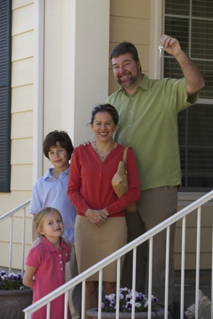


Advantages
Americans love their homes!
Privacy / security / peace of mind
Pride
Personalization
Stability and connection
Appreciation
Tax benefits
Stable costs
Equity build-up
Capital gains

Slide 11
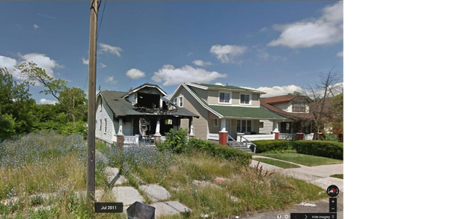

Disadvantages
But homes don’t necessarily return the love.
Long term commitment
Reduced flexibility
Lots of work (labor)
Maintenance expenses
Upfront investment
Higher monthly expenses
Economic deterioration
Capital loss
Loss of equity

Slide 12

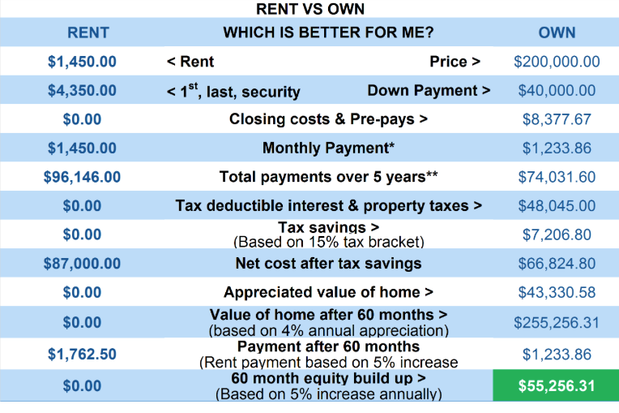
Rent vs. Own
Homeownership is complex.
Use the calculators

Slide 13

Loan Learning
The MESSY Mortgage World

Slide 14
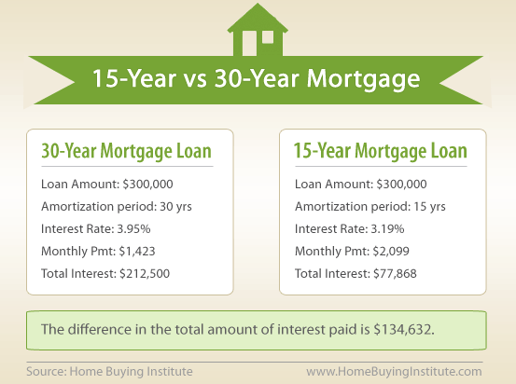
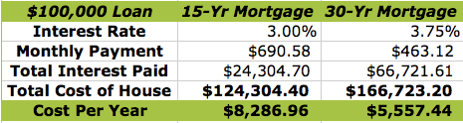
Loan Choices
Loan Options…

Slide 15
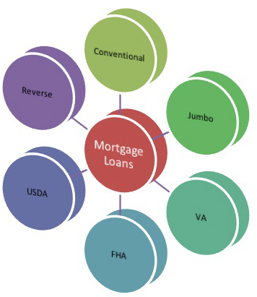
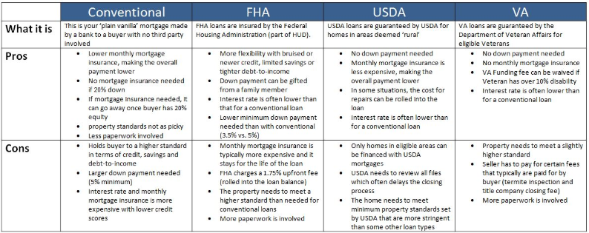
Loan Choices (cont.)
Loan Options…
Loan Term
Interest Rate Type
Loan Type

Slide 16

Loan Tips
Mortgage Loan Tips
Know your budget and plan what YOU can afford.
Save, save, save up a BIG down payment.
Improve credit score.
Seek preapproval.
Shop lenders.
Research, research, research.
Build healthy savings for after purchase.
Seek professional assistance.
Get referrals and do comparisons.

Slide 17


Affordability
How much is Enough?
FIRST
You are limited by…
Your down payment size
Your budget
Your emergency fund
Your credit score
(TIP 1)

Slide 18

Affordability
REMEMBER
(TIP 2)
Closing costs…
Inspection costs and discoveries…
Homeowners Association Dues…
Routine Maintenance…
Improvements…
Insurance…
Cleaning…
Repairs…
Safety…
Taxes…
Pests…
Time…

Slide 19

Affordability
Seek HELP
(TIP 3,4,5)
Ask for recommendations
Check credentials
Find reliable, wise friends and associates
USE THE INTERNET – Government sites

Slide 20
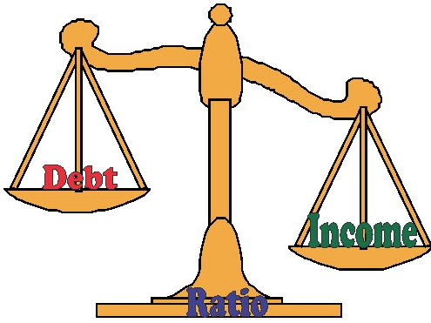
Affordability
Know your PERCENTAGES
(TIP 6)
On average, total shelter expenditures for American households is no more than 35%. (Keep it lower, if possible.)
Loans are available to people whose monthly debt-to-income ratio is below 43%. (Aim to be lower than that!)

Slide 21
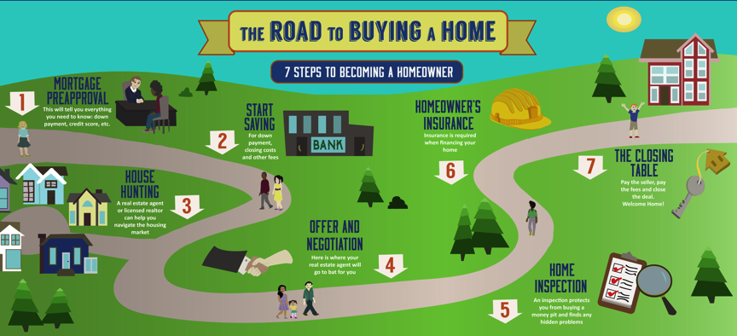
Affordability
The biggest FINANCIAL purchase
of your life…

Slide 22

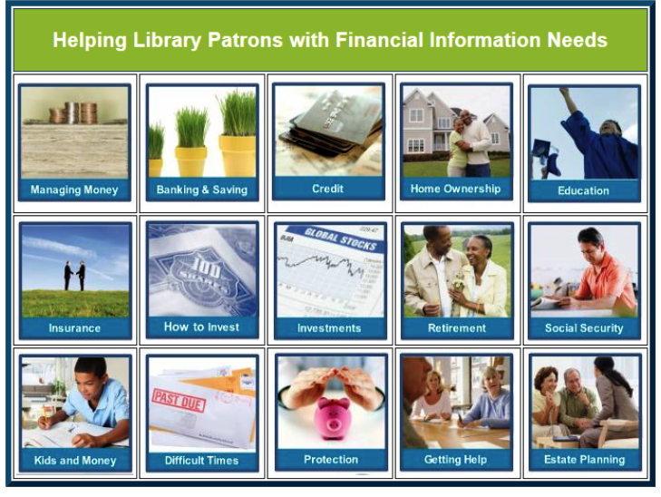
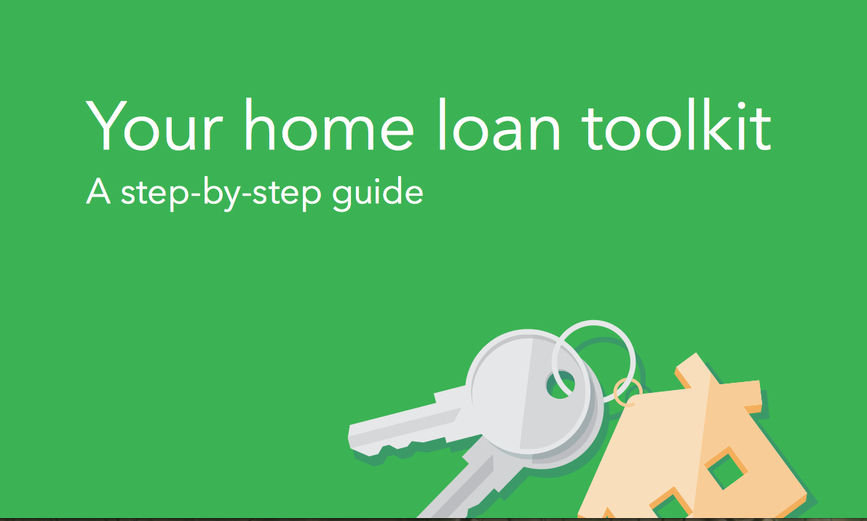
Knowledge!!!
Knowledge, knowledge, knowledge
There is no excuse for NOT knowing!
    Smart Investing FINRA
    HUD
    FHA

Slide 23

Thanks for attending!
Spend less…
enjoy it more!

