Slide 1


Common Investment Types
(to simplify everyone’s investing)

Slide 2

The Estes Valley Library is providing this program through a grant from the Financial Industry Regulatory Authority (FINRA) Investor Education Foundation and the American Library Association (ALA). The grant is distributed as part of the smartinvesting@your library® initiative, an ALA program. This project is in its sixth year of educational partnership with libraries across the country
Marsha Yelick CFA(retired)
Financial Programs Consultant
myelick@estesvalleylibrary.org
970-586-8116 Ext 831

Slide 3




Major themes du jour
The simplest choices are the best.
The more elementary your investments, the more you can be confident you will make and keep your money.
You can understand your own investments!

Slide 4

Why we avoid investing
Common reasons why we avoid investing
We have no experience.
We have no education on the topic.
The market always changes.
We have always been bad at math.
We like to trust experts to do important stuff.
We have no time.
We have no money.
Our “plan sponsors” will do it for us.
Mañana…

Slide 5

Keep it Simple
The Lesson
If you can’t explain it to a six- year-old, you don’t understand it yourself.”
– Albert Einstein

Slide 6

Three types of investments
Three common investment vehicles…
CASH
STOCKS (equity)
BONDS (fixed income)
Simple, old-fashioned, and easy to understand

Slide 7
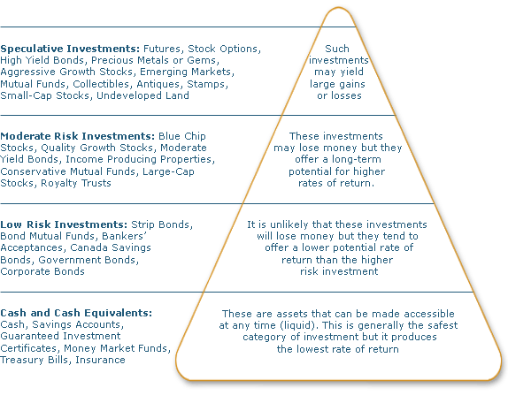
Three Types of Investments
All Investment Types are available
as MUTUAL FUNDS
Stocks
Bonds
Cash

Slide 8


Cash
Cash is…
Real money (not seen much these days)
Checking account
Savings account
Money market account
Short-term C.Ds (two-years and less)
Short-term government bonds
Treasury bills
Insignificant risk of change in value!

Slide 9


Ladder for cash
Ladder cash to increase yield
2 Year CD 1.29%
18 Month CD 1.10%
12 Month CD 1.05%
6 Month CD 0.85%
Money Market Account 0.02%
Checking Account 0.01%
Rates as of 9/1/15 for $10,000

Slide 10

Cash Reserve
How much reserve?
If you are employed...
6-9 months living
expenses…
If you are retired...
1-2 years living
expenses…

Slide 11

Stocks
The racy investment…
What is a stock?
(sometimes called “equity”)
Part-ownership in a company
A claim (very small) on all assets & earnings
A vote on matters that come to the Board
(with no liability except the money you pay).

Slide 12

Stock advantages
So many advantages....
Income (from dividends, perhaps)
Capital growth (historic annual return 10%+)
Easy to buy and sell
Low cost to buy, sell, and hold
Tax advantages
Record keeping helped by brokers statements
Keep pace with inflation

Slide 13
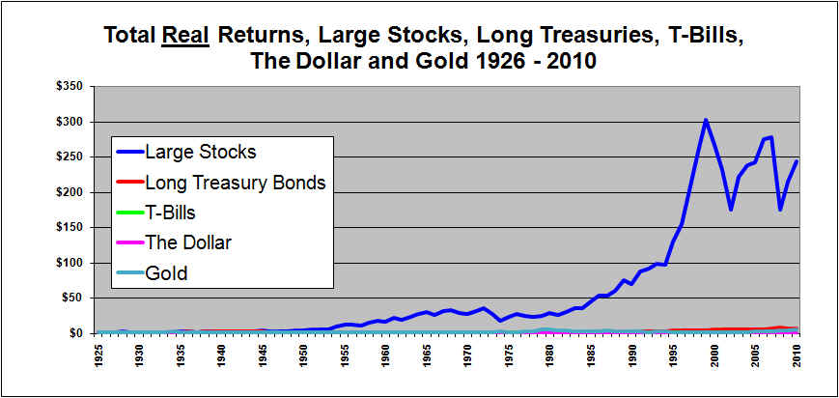
Advantage of equity
You must own stock
Real return means AFTER inflation
http://www.investorsfriend.com/asset_performance

Slide 14

Disadvantage of stock
Allocate correctly (by age) because…
Stock is volatile.
You can lose all your investment.
You may not receive dividends.
Companies go bankrupt (sometimes).
(Maximum 80% of portfolio)
Take more risk when young.
Take less risk as you age.
Always own some stock
(to keep pace with inflation).
(Minimum 20% of portfolio)

Slide 15
Expect from stocks
Review – Good stocks
Average long term return – 10%
  CAPITAL GAINS (only pay tax when stock is sold)
Dividends or other distributions (income)
  If company is profitable, they may choose to distribute some earnings.
Outpace inflation
Liquidity – you can sell whenever you wish
  (and you owe NO taxes on gains until you sell)
Low entry and exit fees and no holding cost
Significant risk of change in value!

Slide 16

Bonds
The more stable investment…
What is a bond?
(sometimes called “fixed income”)
Contract (IOU) you make with a company
(You loan a company money for a specific amount of time at a specific interest rate.)
No vote, no ownership, but higher claim on assets
Interest and return of money loaned

Slide 17

Bond Advantages
Two HUGH advantages...
Predictable current income (historic annual total rate of return = 5%)
Reduce volatility in the value of your investments

Slide 18
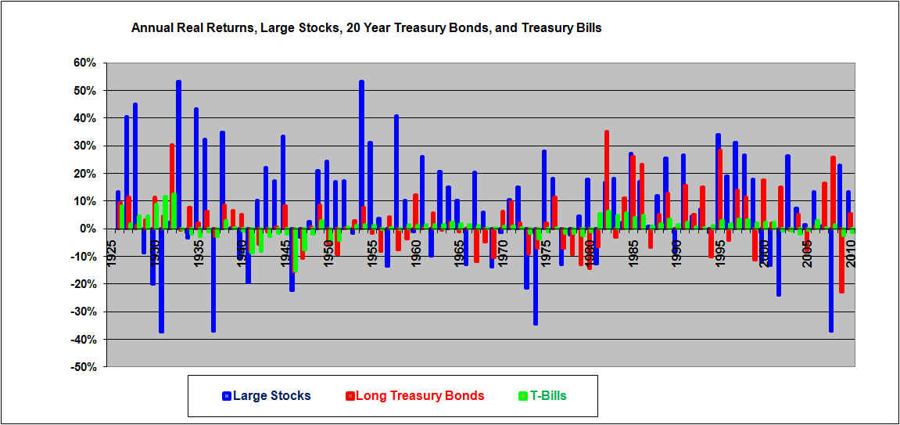
Advantage of bonds
Why you must own bonds
Real return means AFTER inflation
http://www.investorsfriend.com/stocksriskierthanbonds.htm

Slide 19
Disadvantage of bonds
Allocate correctly (by age) because…
Bonds are subject to...
Interest rate risk
Reinvestment rate risk
Call risk
Default risk (rarely)
(and they are not very exciting!)

Slide 20

Expect from bonds
Review - good bonds
Average long term return – 5%
    You will owe tax on the coupon payments(unless tax- free bonds or held in tax- deferred account)
  Less price volatility in your portfolio
Liquidity – you can sell whenever you wish
  (although the market place for small investor is not transparent and you will pay a fee)
No holding cost
You will sleep well at night
LESS risk of large change in value!

Slide 21

Overlooked Bonds
Why don’t people own bonds?
Bonds are sold in LARGE units ($1,000/bond in minimum groups of 5).
Bond pricing is not transparent or simple (risk spread over Treasuries to call or to maturity).
No exchange exists to watch or validate pricing.
Bonds aren’t particularly exciting since there are no “homeruns.”
Although a basic bond is simple, the modern day variations can be extremely complex.

Slide 22
Simple Investing
The simple investment - Mutual Funds
Pool your money with others for greater diversification and a manager to do the work.
(You own a pro rata share of all the fund owns.)

Slide 23
Advantage of Mutual Funds
Advantages for regular investor...
Diversification (huge)
Economies of scale
Liquidity
Convenience/Simplicity
Professional management (???)
=
More time for you!

Slide 24
Disadvantage of Mutual Funds
Some negatives for Mutual Funds
Diversification limits “home runs”
No control of taxable gains/losses
Liquidity but - can only sell at close of market
Professional Management ????
EXPENSES, expenses, expenses…
(front end, back end, annual…)
You still have homework to do

Slide 25
Mutual Fund Expenses
Find low annual expenses
Higher expense funds do not, on average, perform better than lower expense funds.
Front-end fees - AVOID altogether
Back-end fees - Ask so you know, then avoid
12b-1 - Rare today, but ask (covers marketing and management)
Expense ratio (annual operating fees) – these vary each year and can be as high as 2.00% or as low as 0.1%. Aim for something under 0.50% - the lowest quartile.

Slide 26
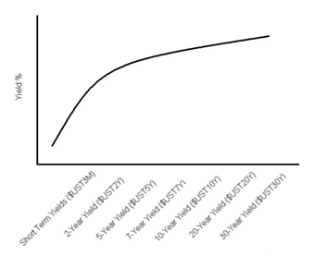
Bond Funds
A Word about Bond Mutual Funds
Marsha’s suggestions:
Buy some short, medium, and long term bond funds.
Buy simple funds with investment grade securities.
Look for lowest fees.
Look for low turnover ratios (Morningstar has these).
If you don’t need the income yet, reinvest interest to dollar cost average until retirement.
You might add some inflation protected bonds.
Try to not watch market volatility. Remember you own for the long-term stability & income.

Slide 27
Exchange-Traded Funds
The newest investment type - ETFs
Like an INDEX MUTUAL FUND, that TRADES during the day on an exchange. You buy shares just like you buy stocks.
ADVANTAGES:
Tax efficient
Low operating costs
DISADVANTAGES:
Unknown, untested indexes
Reporting requirement are not as comprehensive
Used more for short term speculation
May not have sufficient diversification
May lose market favor
Expensive to dollar cost average

Slide 28
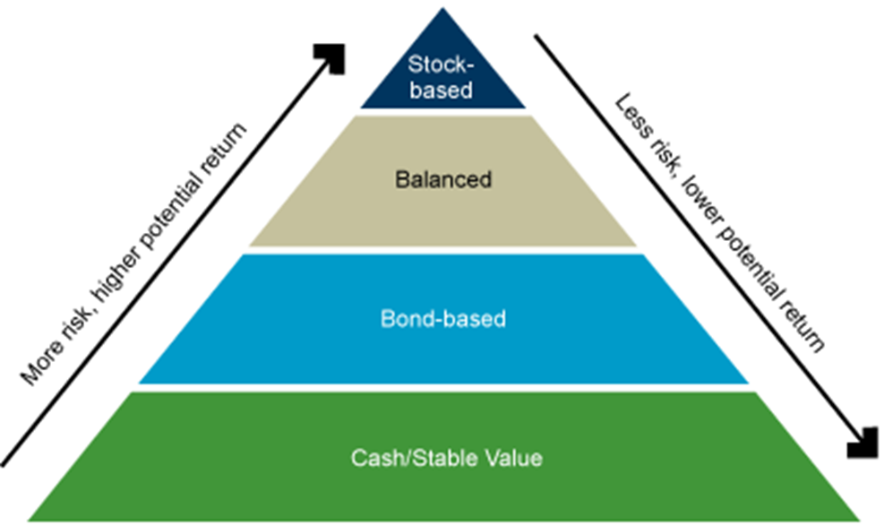
Reminder 1
Remember the Investment Pyramid

Slide 29

Reminder 2
Remember your decade
Every birthday that ends with a ZERO
(20, 30, 40, 50, 60, 70, 80 etc.),
slowly shift some of your allocation from stocks to bonds.

Slide 30

Thank you for attending
Be money smart for life

